Slide 1


DATA SCIENCE
UNIT 3- Data Preprocessing
Presented by:
Sachin Saxena
SME, upGrade

Slide 2
Data visualization tools
Microsoft Excel
Tableau
Qlikview
Datawrapper
Google Data Studio

Slide 3
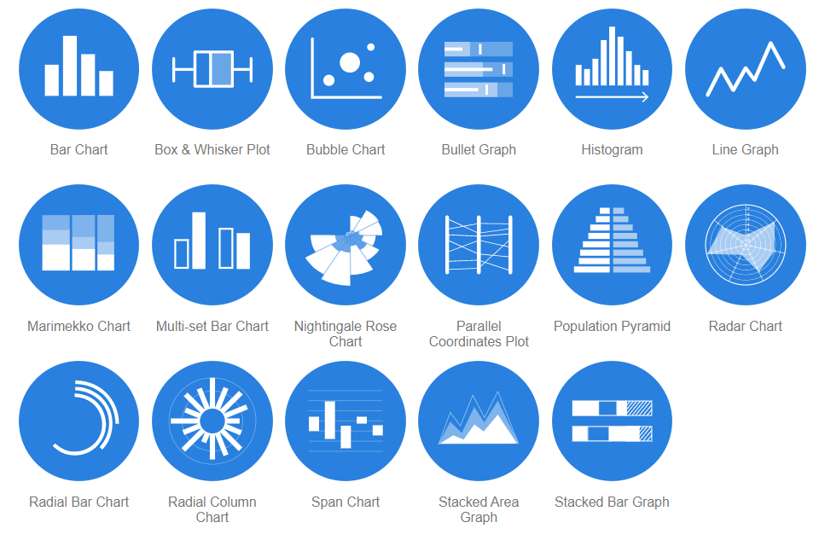
Data Visualization methods
https://datavizcatalogue.com/

Slide 4
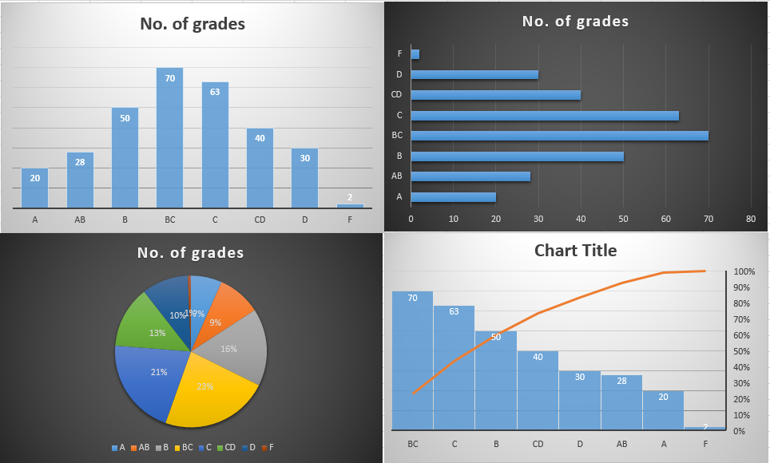
Example in Excel
Grade | No. of grades
A | 20
AB | 28
B | 50
BC | 70
C | 63
CD | 40
D | 30
F | 2

Slide 5
Multidimensional data
http://projector.tensorflow.org/
Visualize a 200 dimensional data

Slide 6
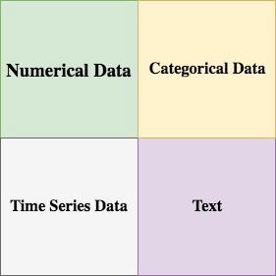
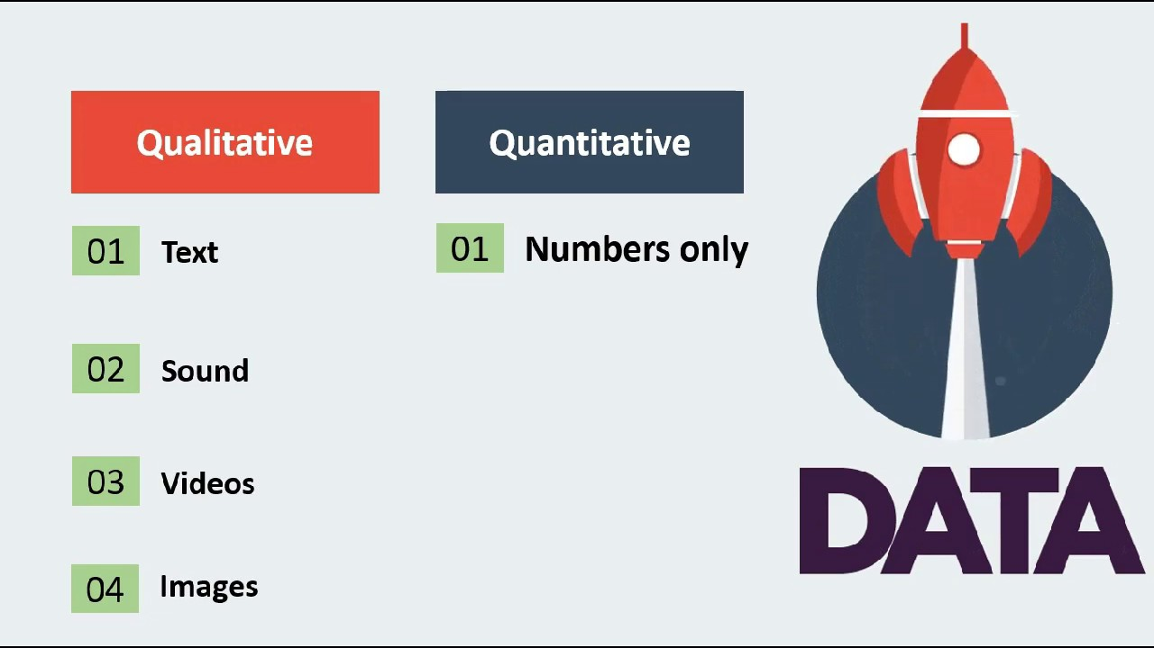
Types of data

Slide 7

https://teachablemachine.withgoogle.com/
Click on Get started

Slide 8
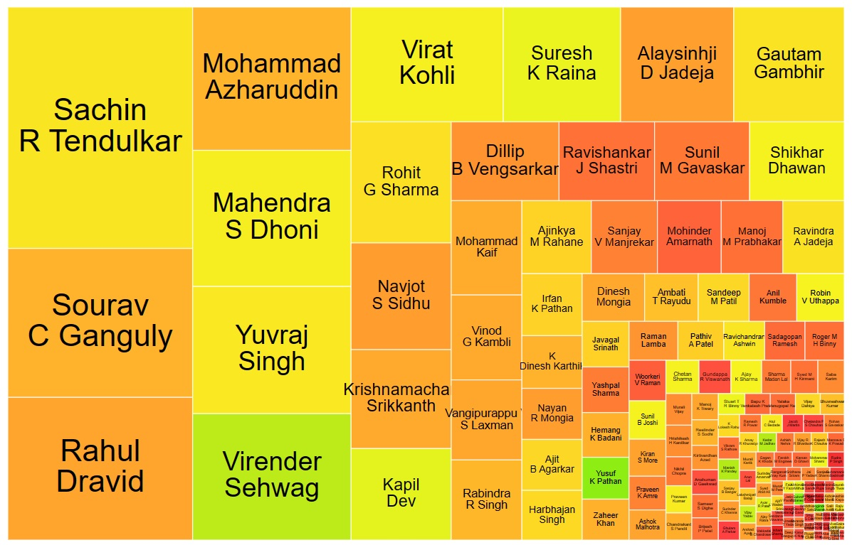
Visualisations - Some Examples:
ODI: Ind batting (gramener.com)

Slide 9
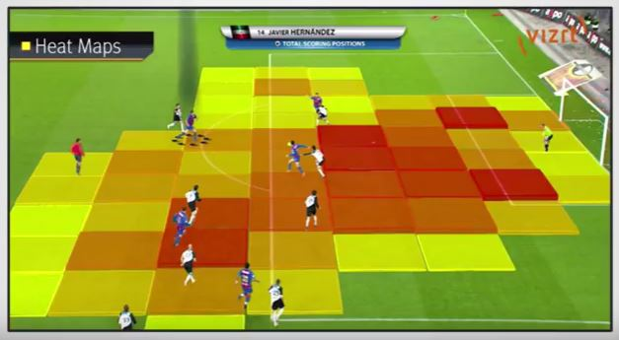
The Necessity of Data Visualisation
Anscombe's quartet – Wikipedia
“numerical calculations are exact, but graphs are rough.”

Slide 10
How do markets react to the budget?
India Budget History (gramener.com)

Slide 11
Software ecosystem
Software ecosystem (gramener.com)

Slide 12
Facts and Dimensions:
Facts and dimensions are different types of variables that help you interpret data better. Facts are numerical data, and dimensions are metadata. Metadata explains the additional information associated with the factual variable. Both facts and dimensions are equally important for generating actionable insights from a given data set. For example, in a data set about the height of students in a class, the height of the students would be a fact variable, whereas the gender of the students would be a dimensional variable. You can use dimensions to slice data for easier analysis. In this case, the distribution of height based on the gender of a student can be studied.

Slide 13
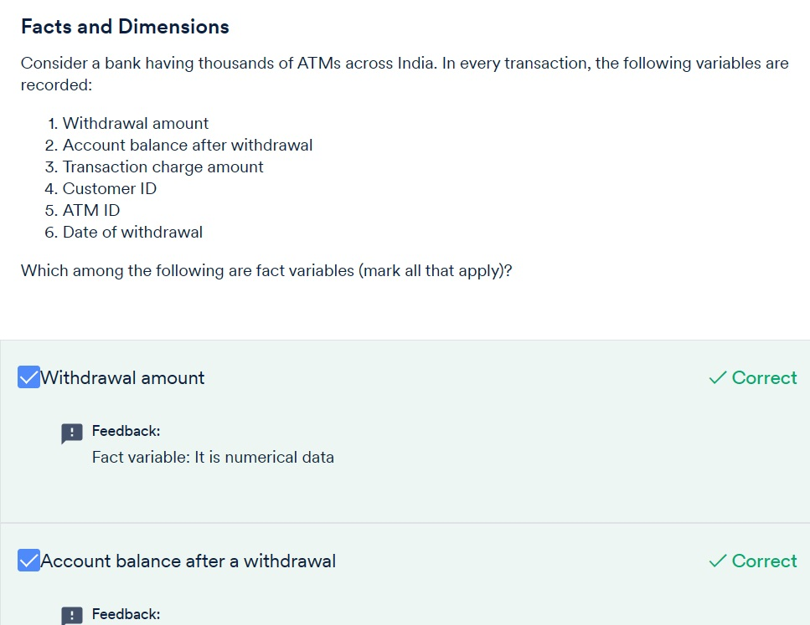

Slide 14
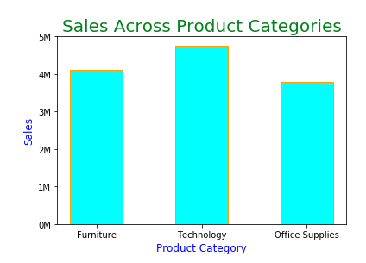
Bar Graph:
Python Code:
Matplotlib+Code+along

Slide 15
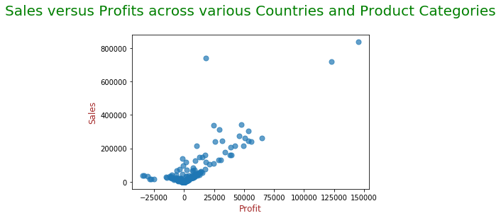
Scatter Plot

Slide 16
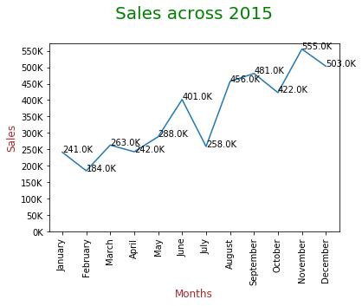
Line Graph and Histogram

Slide 17
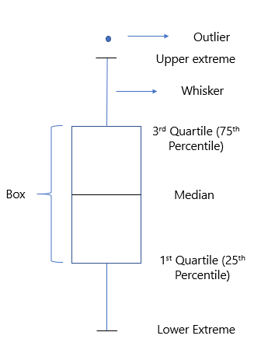
Box Plot:

Slide 18
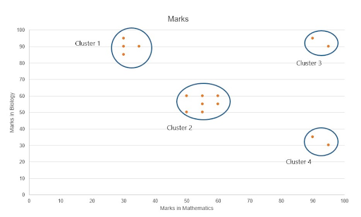
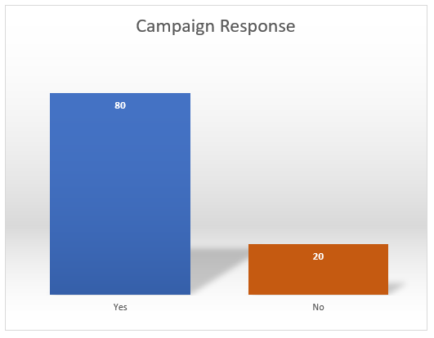
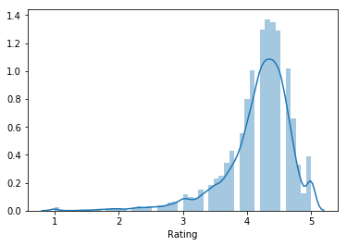
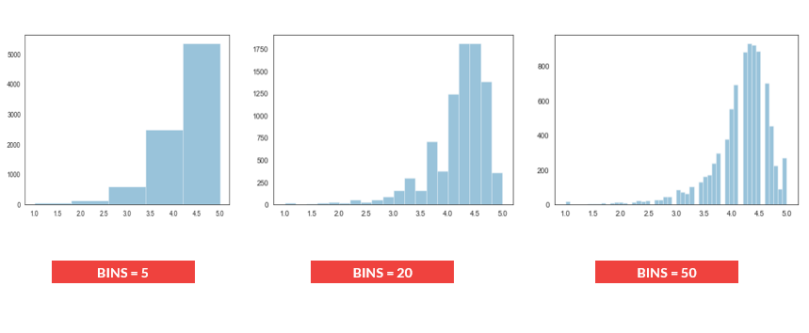

Slide 19
Choosing Plot Types
Python code: 3_1 DataVIZ
PowerPoint Presentation (gramener.com)
The World’s Aging Population Crisis: Visualizing Demographic Transition | SocialCops
14 Best Types of Charts and Graphs for Data Visualization [+ Guide] (hubspot.com)
How to Choose the Right Data Visualization | Tutorial by Chartio

Slide 20
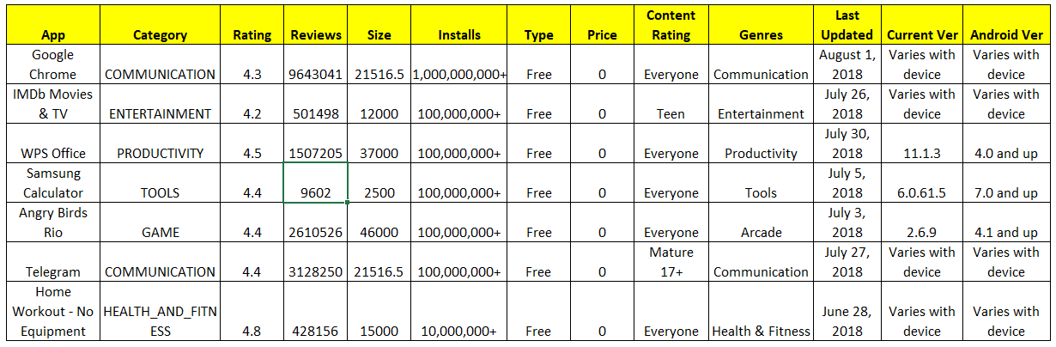
Analysing the Google Play Store Ratings Dataset
Case Study: Mind Map
Python code: 3:2 Case Study Notebook

Slide 21
Data Handling and Cleaning:
Missing values: You would almost always encounter data which have rows where no observation is recorded for a certain variable. These can affect the analysis process and the generated insights significantly. Some common techniques to treat this issue are
Imputation, where you replace the missing value with another estimated value
Dropping the rows containing the missing values altogether or depending on the case, you can also go ahead and keep the missing values as long as they don’t affect the analysis.

Slide 22
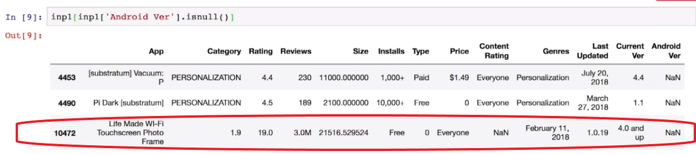
Data Handling and Cleaning: II

Slide 23
Python: Practice Questions
3_3 Practice Exercise - Session 1

Slide 24
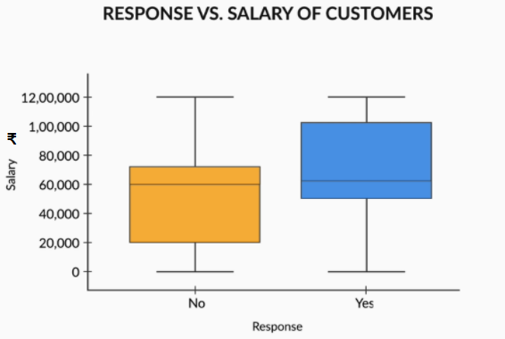
EDA:
the box plot of the banking data set gives a clear idea that more positive responses came from people with higher salaries because 50% of the data with a 'yes' response lies in the higher salary region.

Slide 25
Private Data: data in the banking, telecom and human resources sectors.
Banking data: Banks use data to make credit-related decisions. This data is highly sensitive, as it contains customer transaction details, account details, etc. Security of such data is of topmost importance. Banks can use such data to predict which customer is likely to take a loan in the near future or which customers are interested in investing in term deposits, etc. With this help of such data, banks can also identify which customers are likely to default on their loans.
Telecom data: Telecom companies use data to optimise plans for customers and predict customer churn. Telecom data can be used to optimise the coverage area based on the customers' calls data and their call performances.
HR data: HR data analytics helps identify and predict employee behaviour.

Slide 26
Web Scraping-I
The IMDB website provides movie-related information such as release date, runtime duration, cast, genre, ratings, etc. Now, consider a specific webpage on the IMDB website that lists the top-rated movies along with information about them. It lists the top 50 rated movies, the number of votes, etc. Now, what if you want to perform a deeper analysis to answer certain questions as follows?
Which director has the highest number of movies in the top 50 rated movies?
Which genre has the highest rating among the top 50 rated movies?
What is the gross expenditure of the lowest-rated movies as compared with the highest-rated ones?

Slide 27
Web scraping helps to fetch such information from websites. You will learn about web scraping in three parts:
Need for and application of web scraping
The basics of an HTML page
Python libraries and codes for web scraping

Slide 28
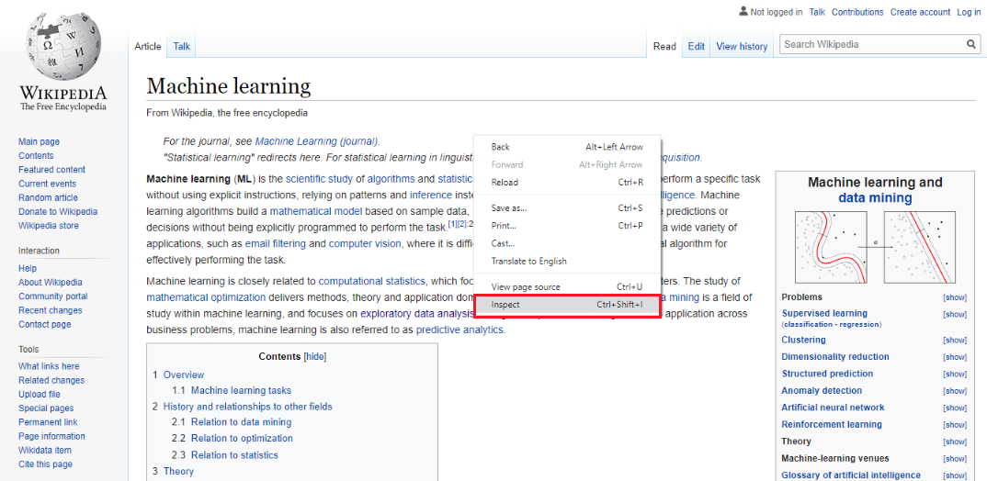
HTML Page:
Open web page ->
Right-click ->
Inspect

Slide 29

Python Code:
3_4 Web+Scraping_imdb+(1).ipynb

Slide 30
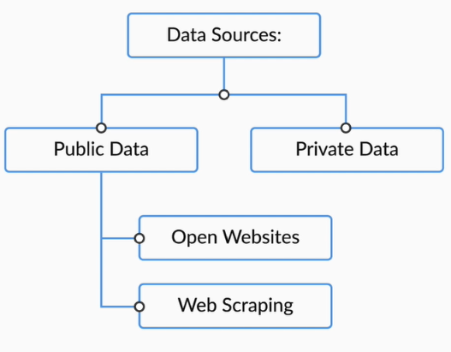
Given below are the links to some public datasets. You may explore these open sources to get the data:
GitHub: Awesome public data sets, Github data sets
Open government data set: Open Government data.
Kaggle website link: Kaggle Website
UCI repository of machine learning: UCI machine learning data set repository.

Slide 31
Distribution Plots:
plotted a distribution plot to check the distribution of ratings using both the Matplotlib function and the Seaborn functions. In the latter case, you must have noticed that instead of the hist command, you are now using a distplot or a distribution plot. The corresponding Seaborn command is sns.distplot(inp1.Rating).
The distplot in Seaborn directly computes the probability density for that rating bucket.

Slide 32
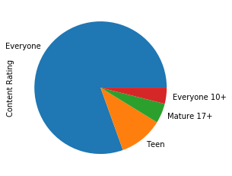
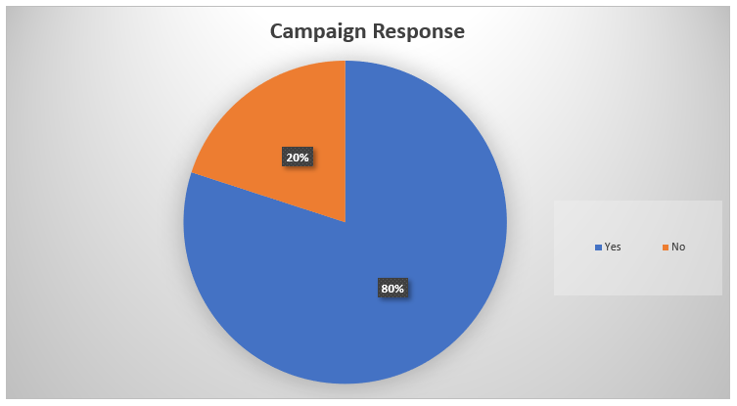
Pie - Chart and Bar Chart:
in the case of categorical variables, you need to use aggregates or measures like sum, average and median to plot the visualisations.

Slide 33
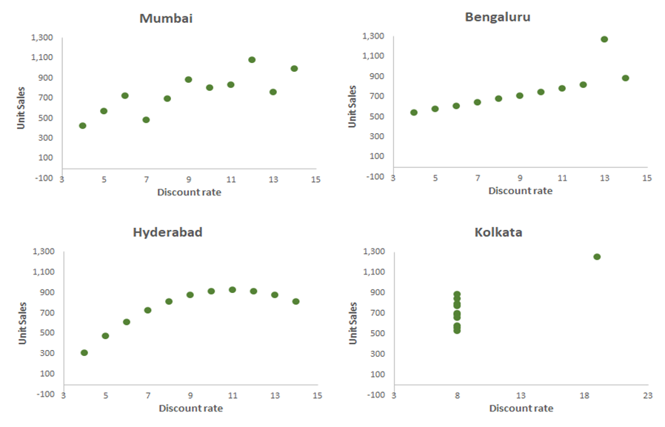
Scatter Plots:
If you want to plot the relationship between two numeric variables, you will be using something known as a scatter plot.

Slide 34
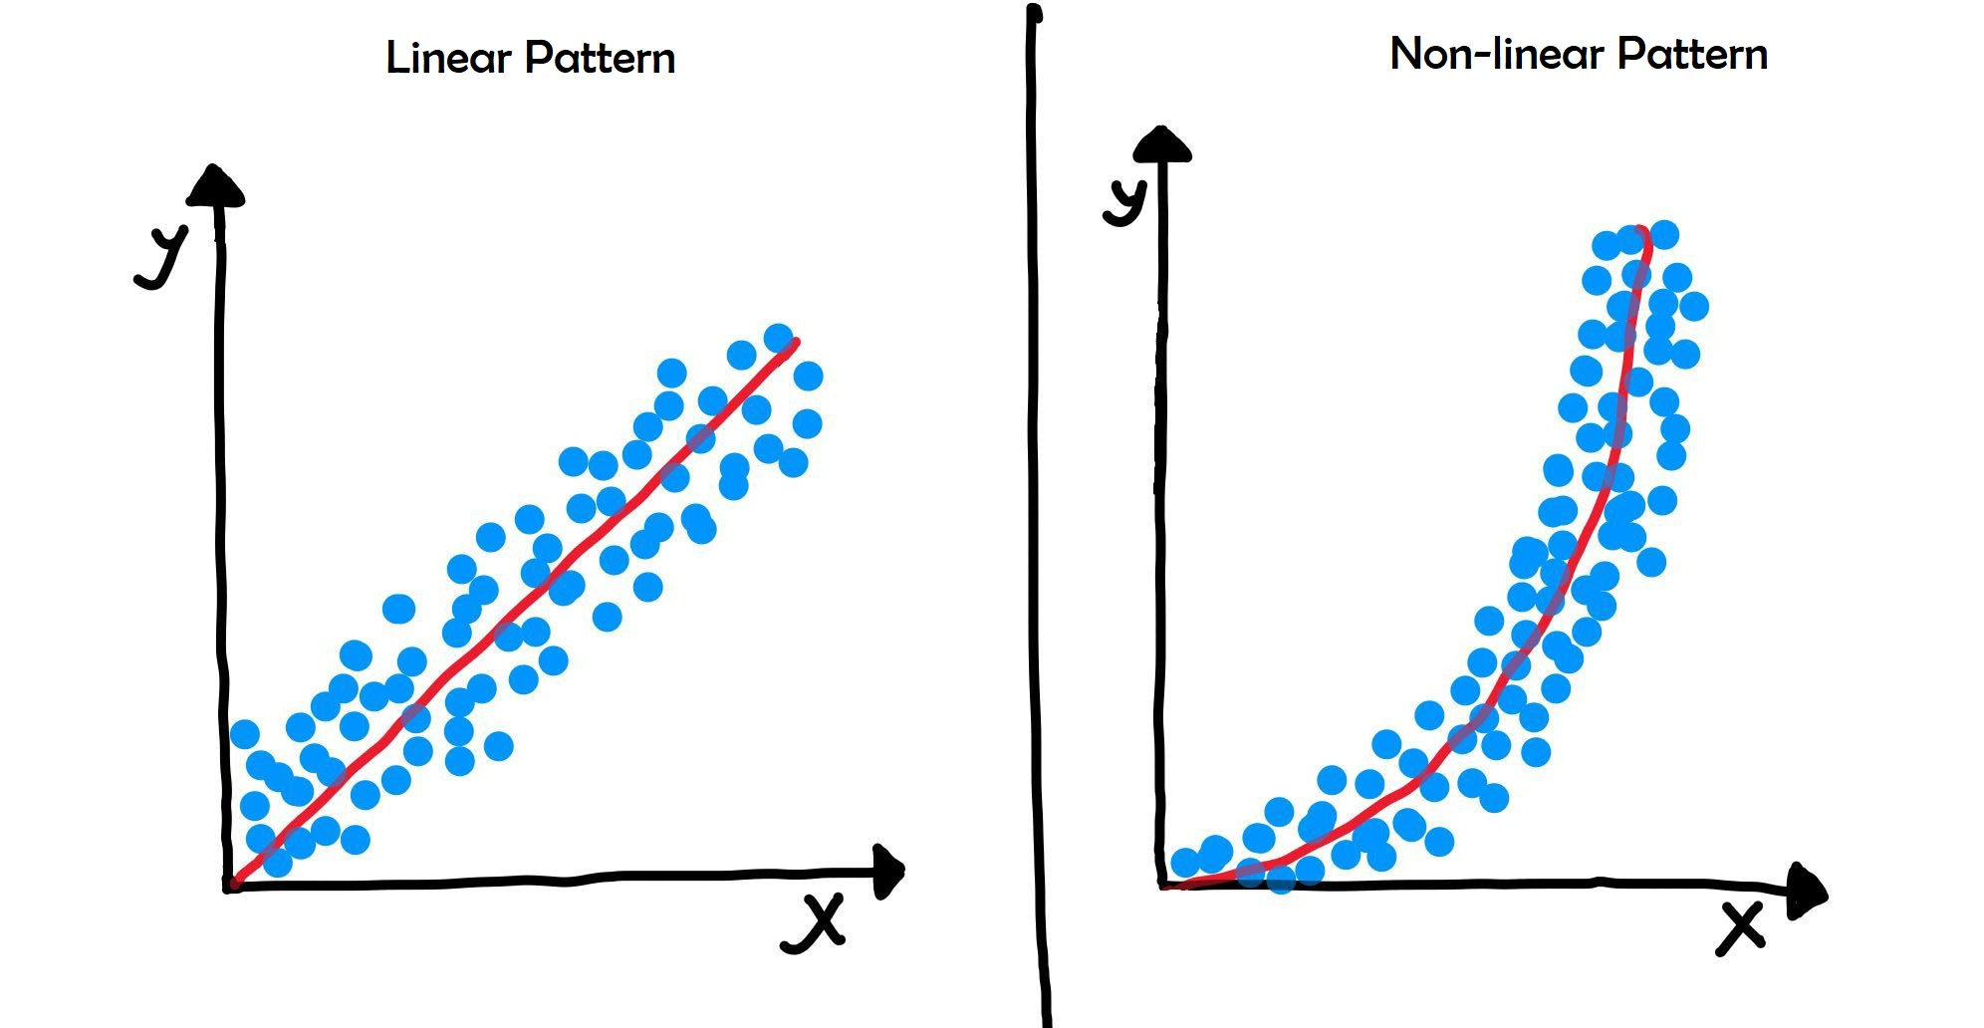
Applications of scatter plots in machine learning:

Slide 35
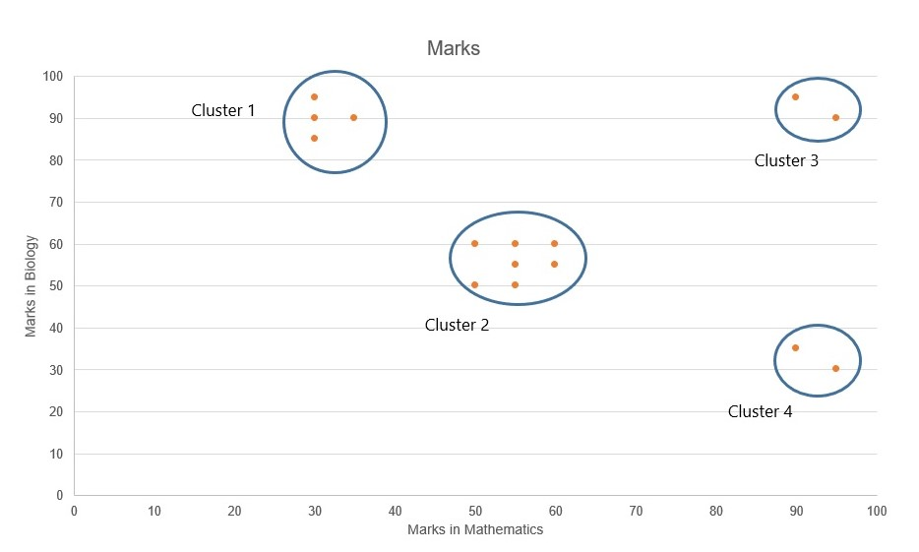
Applications of scatter plots in machine learning:

Slide 36
Pearson’s r value is a metric to measure the correlation between 2 numerical entities. You can read more about it in the following link
Scatter plots can show the trends for only 2 numeric variables. For understanding the relationships between 3 or more, you need to use other visualisations.

Slide 37
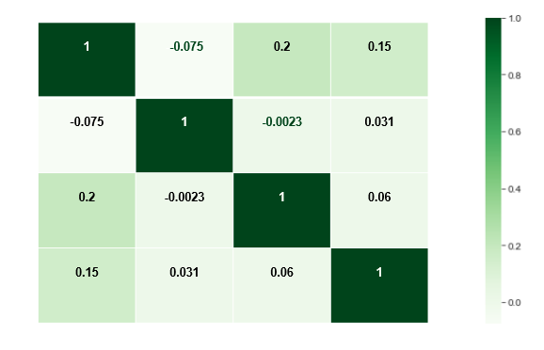
Heatmaps:
Heat maps also utilise the same concept of using colours and colour intensities to visualise a range of values. You must have seen heat maps in cricket or football broadcasts on television to denote the players’ areas of strength and weakness.

Slide 38
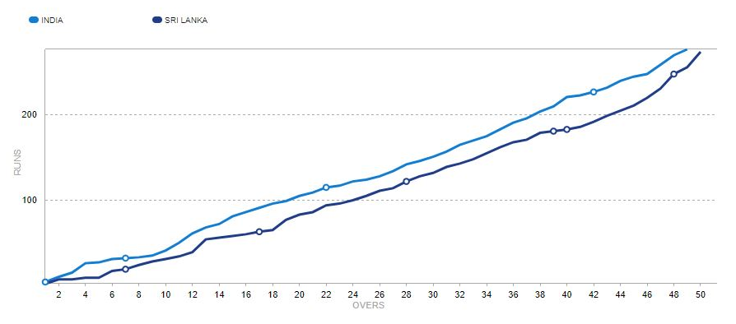
Line Charts:
This graph is an example of a line graph (when drawn at such a scale it resembles a “crawling worm”). Its main feature is that it utilises continuous time-dependent data to accurately depict the trend of a variable.

Slide 39
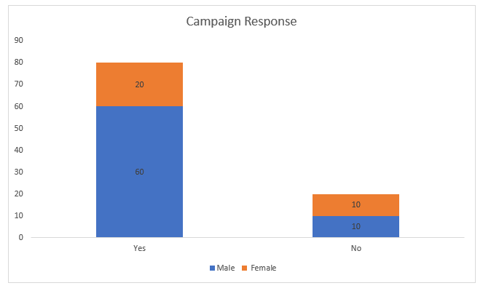
Stacked Bar Charts:

Slide 40
Summary of case study:
First, you did a fair bit of data handling and cleaning - cleaning junk records, adding missing values, changing data types, remove outliers, etc.
When you analysed the ratings using the histogram, you saw that they are skewed towards higher ratings.
Using a bar chart, you saw that most of the apps belong to the Everyone category.
You also observed a weak trend between the ratings and the size of the app, using a scatter-plot. You also briefly forayed to reg plots to understand its nuances.
Using a pair-plot, you were able to see multiple scatter plots and draw several inferences, for example, price and rating having very weak trend, reviews and price being inversely related and so on.
After that, you utilised estimator functions along with bar plots as well as box plots to observe the spread of ratings across the different Content Rating Categories. Here, your main observation was that Everyone category has a lot of apps having very low ratings.
Finally, you created a heat map comparing the ratings across different Reviews and Content Rating buckets.

Slide 41
Plotly
Plotly is a Python library used for creating interactive visual charts. You can take a look at how you can use it to create aesthetic looking plots with a lot of user-friendly functionalities like hover, zoom, etc.
[First, you need to install Plotly on your local machine. Take a look at this link for instructions as well as documentation for the library.]

Slide 42
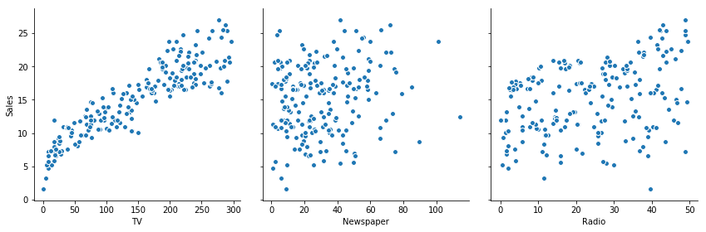
Python Case Study:
3_5 Case Study Notebook (Completed)

Slide 43
Practice Questions Solution: Data Visualisation
3_6 Practice Questions - Solution

Slide 44
Data Types
For data analysis, you will use the following libraries through the entire module, which you must have already covered in prep content:
Pandas: It is a library to deal with dataframes in Python. Pandas is an acronym derived from panel data. It is solely used for data analysis purposes in Python.
NumPy: This library is used for performing numerical operations on a dataset.

Slide 45
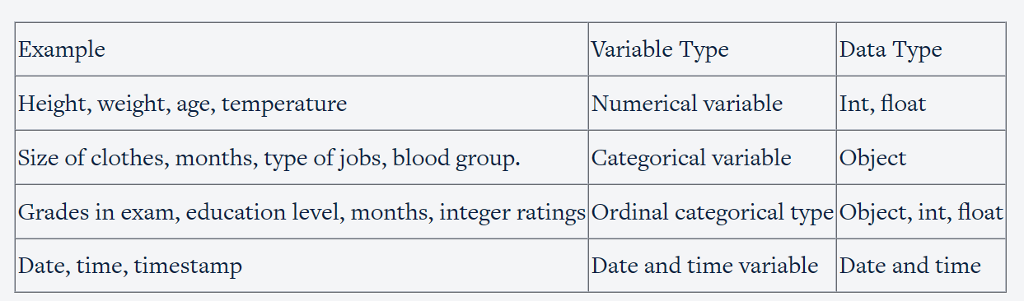
Data Types

Slide 46
Fixing the Rows:
Checklist for fixing rows:
Delete summary rows: Total and Subtotal rows
Delete incorrect rows: Header row and footer row
Delete extra rows: Column number, indicators, blank rows, page number

Slide 47
Fixing the Columns:
Checklist for fixing columns:
if needed, merge columns for creating unique identifiers, for example, merge the columns State and City into the column Full Address.
Split columns to get more data: Split the Address column to get State and City columns to analyse each separately.
Add column names: Add column names if missing.
Rename columns consistently: Abbreviations, encoded columns.
Delete columns: Delete unnecessary columns.
Align misaligned columns: The data set may have shifted columns, which you need to align correctly.

Slide 48
Example: 3_7 Data+Cleaning+_+Checklist.xlsx

Slide 49
Impute/Remove Missing Values:
Set values as missing values: Identify values that indicate missing data, for example, treat blank strings "NA", "XX", "999", etc., as missing.
Adding is good, exaggerating is bad: You should try to get information from reliable external sources as much as possible, but if you can’t, then it is better to retain missing values rather than exaggerating the existing rows/columns.
Delete rows and columns: Rows can be deleted if the number of missing values is insignificant, as this would not impact the overall analysis results. Columns can be removed if the missing values are significant in number.
Fill partial missing values using business judgement: Such values include missing time zones, century, etc. These values can be identified easily.

Slide 50
Types of missing values:
MCAR: It stands for Missing completely at random. The reason behind the missing value is not dependent on any other features.
MAR: It stands for Missing at random. The reason behind the missing value may be associated with some other features.
MNAR: It stands for Missing not at random. There is a specific reason behind the missing value.

Slide 51
THANK YOU

